Slide 1
SYSTEMS ANALYSIS AND DESIGN
Nguyen Thanh Binh, Nguyen Quang Vu, Le Viet Truong, Nguyen Thi Hanh, Vo Van Luong, Le Thi Bich Tra
Faculty of Computer Science

Slide 2
UML and Software Development Process
Software Development Activities
Object-Oriented Analysis and Design
Software Development Process
UML and Software Development Process

Slide 3
Main Software Development Activities
Requirements Gathering
Define requirement specification
Analysis
Define the conceptual model
Design
Design the solution / software plan
Implementation
Code the system based on the design
Integration and Test
Prove that the system meets the requirements
Deployment
Installation and training
Maintenance
Post-install review
Support docs
Active support

Slide 4
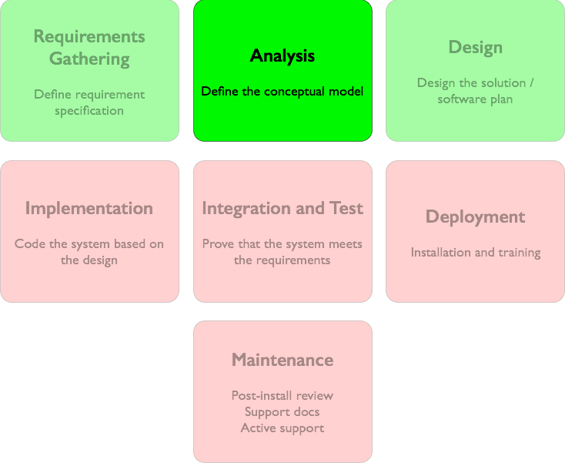

Object-Oriented Analysis and Design
Analysis emphasizes an investigation of the problem and requirements, rather than a solution.
During object-oriented analysis, there is an emphasis on finding and describing object or concepts in the problem domain.
If a cash register system at the supermarket is desired
How will it be used?
What are its functions?

Slide 5
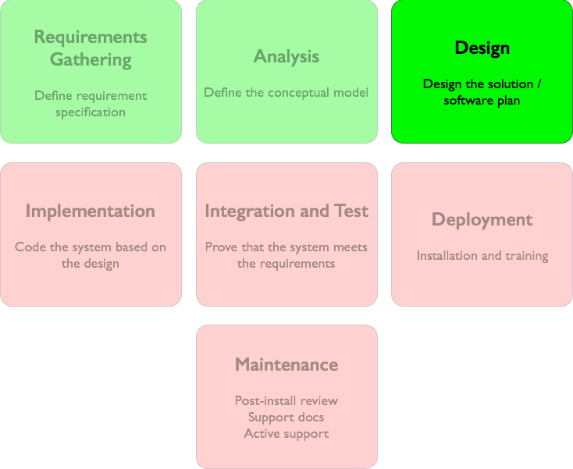
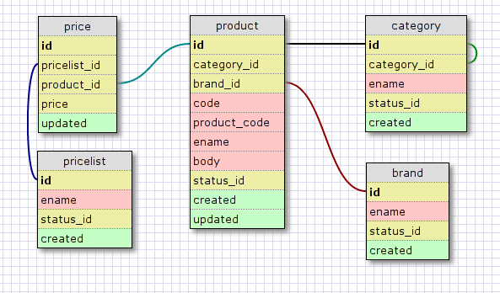
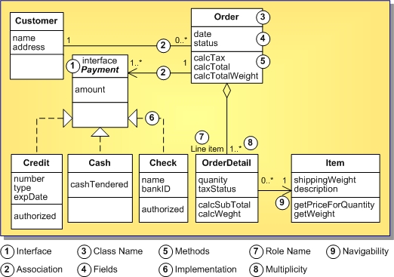
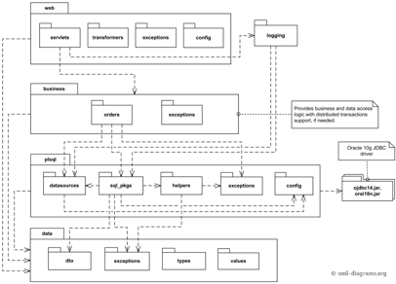
Object-Oriented Analysis and Design
Design emphasizes a conceptual solution in software that fulfils the requirements and “guides” the implementation.
During object-oriented design, there is an emphasis on defining software objects and how they collaborate to fulfil the requirements.
Class diagram
Database schema
Package diagram
Design specification of the cash register system

Slide 6
Object-Oriented Analysis and Design

Slide 7
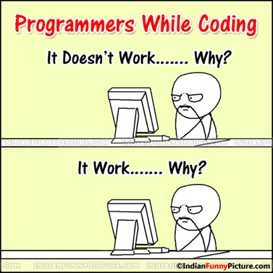
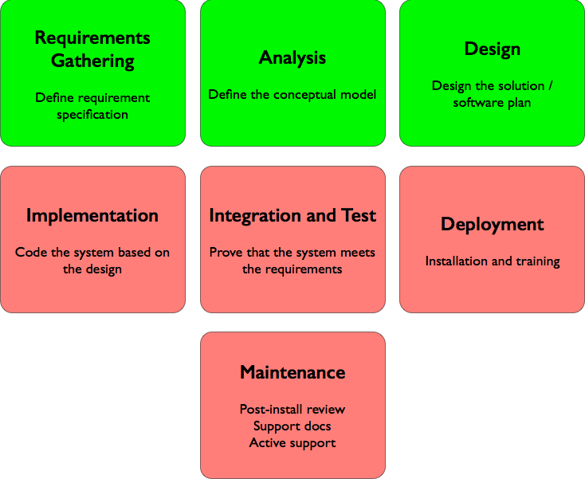
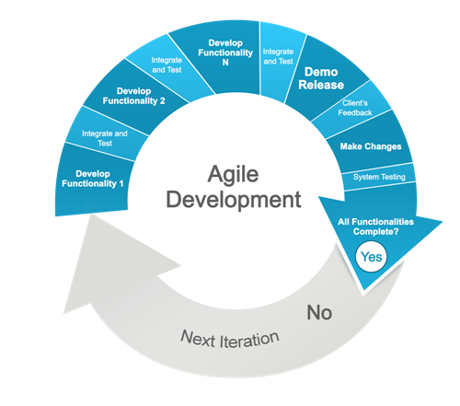
Software development process
Software development process is a series of software development activities that a software program goes through when developed
Requirements
Specification
Software development processes
Analysis
Design
Implementation
Integration and
Test
Deployment
Maintenance

Slide 8

Ad-hoc Coding “process”
Does not scale to large size project
Does not scale to large development teams

Slide 9

Waterfall process
Requirements
Specification
Analysis
Design
Sequential
Implementation
Integration and
Test
Deployment
An phase is begun only when the previous has finished
No return to previous phase
Maintenance

Slide 10
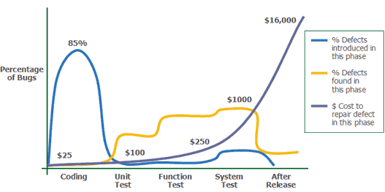
Critique of Waterfall process
Responds poorly to changes and problems
Substantial upfront document
Assumes fixed specification - may not be what customer wants
Fixes come very late - costlier to fix later time
Source: Applied Software Measurement, Capers Jones, 1996.

Slide 11
Iterative and Agile Development Processes

Slide 12
Facts of life
Requirements change, changes break existing design.
Coding up a design suggests flaws in design
Testing identifies flaws in code - which could be design flaws
Maintenance requires not only fixes but new features

Slide 13
Philosophy
Embrace change
Don’t do too much, too soon
Individuals and interactions over processes and tools
Working software over comprehensive documentation
Customer collaboration over contract negotiation
Responding to change over following a plan

Slide 14
Early coding, early testing of partial system
in repeating cycles.
Development begins before all requirements are defined in detail.
Feedback is used to clarify evolving
specification.

Slide 15
Benefits
Less project failure, better productivity,
and lower defect rates
Early rather than late mitigation of high risks
Early visible progress
Managed complexity - the team is not overwhelmed by “analysis paralysis” or very long and complex steps
Early feedback, user engagement, and adaptation, leading to a redefined system that more closely meets the real needs of the stakeholders
Feedback can also improve development process itself

Slide 16
Agile software development methods
Adaptive software development (ASD)
Agile modeling
Agile Unified Process (AUP)
Crystal Clear Methods
Disciplined agile delivery
Dynamic Systems development method (DSDM)
Extreme programming
Feature-driven development (FDD)
Lean software development
Kanban
Scrum

Slide 17
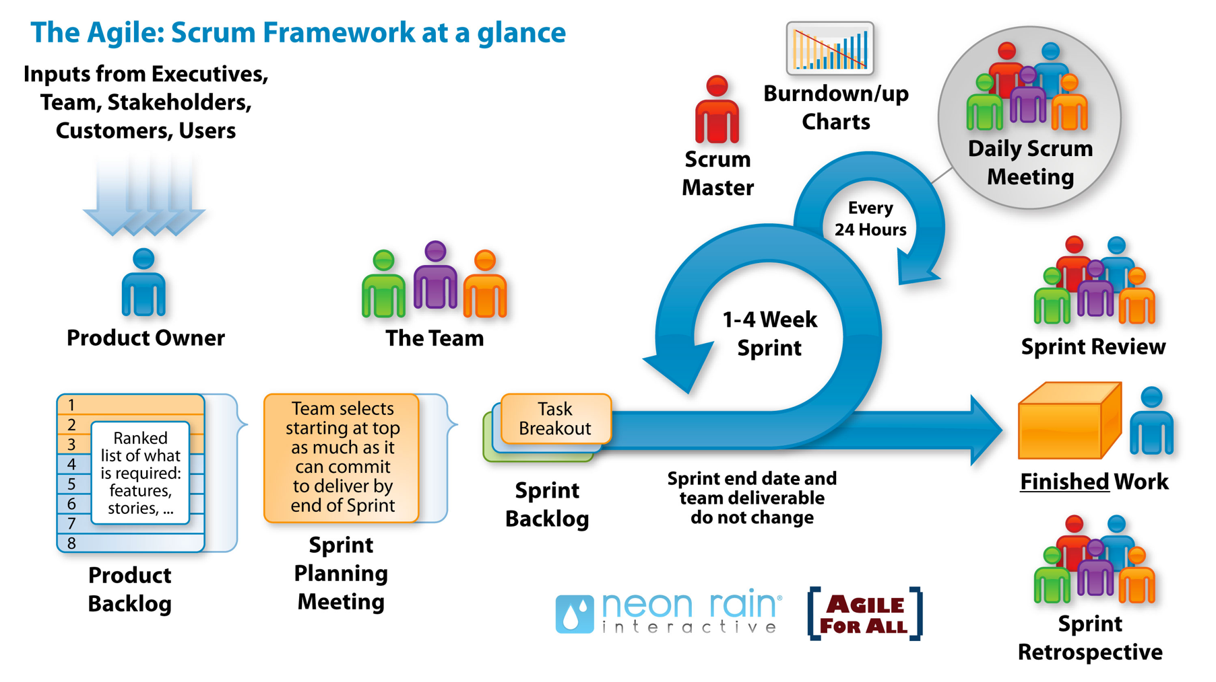
Scrum

Slide 18

UML can be used in many software development process
+
Requirements
Specification
Software development processes
Analysis
Design
Implementation
Integration and
Test
Deployment
Maintenance

Slide 19

UML diagrams can be applied to several activities
ο : possible usage
• : recommended usage
 | Requirements | Analysis | Design
Use-case | •
Class, object |  | • | •
Activity |  | • | ο
State |  | • | •
Interaction |  | ο | •
Component |  |  | •
Deployment |  |  | •

